Slide 1
Discussion Module:
Learn to deliver DSE spatial queries, including time series. For example:
Did the pizza driver pass a given point ? (Where’s my pizza ?)
Is there hotel room availability for a given date ?
Prerequisites to this Discussion Module:
That you are comfortable with making and using DSE Search geospatial objects and queries.
Spatial (not geospatial), Time Series
Notes:
The goal of this Discussion Module is to learn to deliver DSE Search spatial queries; Where’s my pizza, and related.
This module has as its prerequisites:
That you are comfortable with DSE Search geospatial.

Slide 2
Discussion Lab:
Next page: Describe/offer business use cases-
Open Probe
Open Probe
Notes:
On the next page we enter a Discussion Lab.

Slide 3
Discuss: Spatial, and Time-
Describe business use cases for:
Knowing that a driver passed through a given location ?
Or didn’t pass though a given location ?
Is in a location ?
A resource is/is-not available on a given date ?
How is a Lat/Lon pair similar to a span of time ?
Notes:
Open probe: Discuss the topics above-

Slide 4
End of Discussion Lab:
Notes:
End of Discussion Lab-

Slide 5
DSE Search, Spatial, Time Series
Use RPT, geo=‘false’
Set; worldBounds, maxDistErr, distErrPct
Casting; POINT, LINESTRING
Operators; IsWithin, Intersects, [] (Range)
Notes:
If you know DSE Search geospatial queries, you already know 95% of DSE Search spatial queries.
Using RPT, change geo=‘false’. (Recall default is true.)
Commonly use the parameters; worldBounds, maxDistErr, disErrPct
Use the operators POINT and LINESTRING to cast input data values.
For spatial, use the operators; IsWithin, Intersects, other.
For time series, use; [ ] (the range operator).
Reference Urls:
https://docs.datastax.com/en/dse/5.1/dse-dev/datastax_enterprise/search/queriesGeoSpatial.html

Slide 6

End to End Example:
Working with routes-
IsWithin, Intersects, POINT, LINESTRING
Notes:
At this point we present an example; complete, and end to end.
This example details how to work with routes.

Slide 7

IsWithin, Intersects, CREATE KEYSPACE
DROP KEYSPACE IF EXISTS ks_7455;
CREATE KEYSPACE ks_7455 WITH REPLICATION =
{'class': 'SimpleStrategy',
'replication_factor': 1};
USE ks_7455;
Notes:
Familiar CQL code; make a keyspace and table.

Slide 8


IsWithin, Intersects, CREATE TABLE
CREATE TABLE t1
(
col1 TEXT,
my_point 'PointType',
my_line 'LineStringType',
PRIMARY KEY ((col1))
);
Or TEXT-
There really aren’t sane/usable assumptions for these, to allow default generation
Notes:
CQL CREATE TABLE. Comments:
While there are PointType and LineStringType helpers (native column types), really/currently they only serve to self-document. There just isn’t a current means to specify all of the properties necessary to create a useful POINT, or useful LINESTRING.

Slide 9
IsWithin, Intersects, Add Data
INSERT INTO t1 (col1, my_point, my_line)
VALUES ('1', 'POINT(10 10)',
'LINESTRING(10 10, 10 20, 10 30, 20 30, 20 20)' );
VALUES ('2', 'POINT(10 10)',
'LINESTRING(10 10, 10 20, 10 30, 20 30, 20 20, 20 10, 20 0)' );
VALUES ('3', 'POINT(30 30)',
'LINESTRING(30 30, 30 40, 20 40, 20 30, 20 20, 10 20, 10 30, 20 30)' );
VALUES ('4', 'POINT(20 30)',
'LINESTRING(20 30, 20 20, 10 20, 0 20)' );
Notes:
Adding data.
Since we will be using RPT, data is added without commas between the 2 dimensions.

Slide 10
Same Data, Plotted, Page 1 of 2
40
40
30
30
20
20
10
X
10
X
10
20
30
40
10
20
30
40
Notes:
A visual representation of the data; used later.

Slide 11
Same Data, Plotted, Page 2 of 2
40
40
X
30
30
X
20
20
10
10
10
20
30
40
10
20
30
40
Notes:
A visual representation of the data; used later.

Slide 12

LINESTRING data can not-
40
30
X
InvalidRequest: Error from server: code=2200 [Invalid query] message="Unable to make LineStringType from 'LINESTRING(30 30, 30 40, 20 40, 20 30, 20 20, 20 10, 30 10, 30 20, 20 20, 20 10, 20 0)' 'LINESTRING (30 30, 30 40, 20 40, 20 30, 20 20, 20 10, 30 10, 30 20, 20 20, 20 10, 20 0)' is not simple. Points and edges cannot self-intersect."
20
10
10
20
30
40
Notes:
Using just Lucene (the underlying runtime libraries), LINESTRING values can not overlap.
The technique then is to split overlapping (routes) into multiple records.

Slide 13
JIRA, DSP-11516
You can not smudge the values. E.g., add 0.00001 or similar to overlapping points.
https://datastax.jira.com/browse/DSP-11516
You have to break these LINESTRINGS in two-
Notes:
A technique would be to offset overlapping routes by some tiny amount, however; JIRA DSP-11516 gets in the way of this technique.

Slide 14
IsWithin, Intersects, CREATE SEARCH INDEX
// CREATE SEARCH INDEX ON t1
// WITH COLUMNS col1, my_point, my_line;
//
// InvalidRequest: Error from server: code=2200 [Invalid query]
// message="The search index schema could not be auto-generated
// because: Type org.apache.cassandra.db.marshal.LineStringType
// is not supported with automatic Solr schema generation.
// Specify 'lenient: true' in your resource generation options
// to ignore unsupported columns."
CREATE SEARCH INDEX ON t1
WITH COLUMNS col1, * {excluded : true } ;
Notes:
The CREATE SEARCH INDEX, at bottom of page.
The first line; displaying what would happen if you try to index the POINT or LINESTRING using default values.

Slide 15
ALTER SEARCH INDEX, deploy
ALTER SEARCH INDEX SCHEMA ON t1
ADD types.fieldType[@name='ft_rpt',
@class='solr.SpatialRecursivePrefixTreeFieldType',
@geo='false',
@worldBounds='ENVELOPE(-1000, 1000, 1000, -1000)',
@maxDistErr='0.001', @distanceUnits='degrees'];
ALTER SEARCH INDEX SCHEMA ON t1
ADD fields.field[@name='my_point', @type='ft_rpt',
@indexed='true', @multiValued='false', @stored='true',
@docValues='true'];
ALTER SEARCH INDEX SCHEMA ON t1
ADD fields.field[@name='my_line', @type='ft_rpt',
@indexed='true', @multiValued='false', @stored='true',
@docValues='true'];
RELOAD SEARCH INDEX on t1;
REBUILD SEARCH INDEX ON t1;
Notes:
The ALTER SEARCH INDEX statements. Comments:
For a geo=‘true’, the world boundaries are known.
For non geospatial (I.e., spatial), the boundaries are not know. For a calendar, it might be 365/366 calendar days. For time it might be 0 – 2400 minutes in a day.
Number of seconds in a day is considered fair use.
Heuristically (public Web boards), it is not recommended that you index thousands of a second granularity.

Slide 16
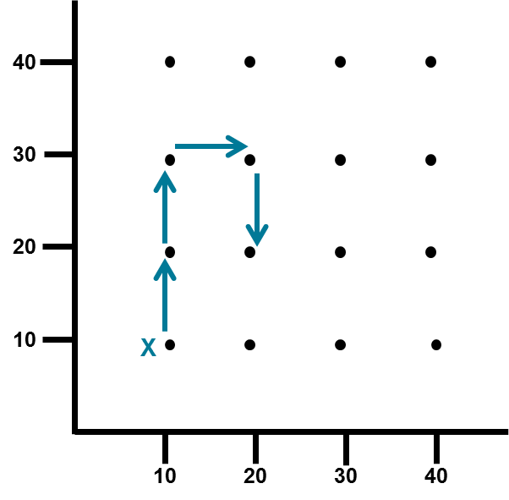
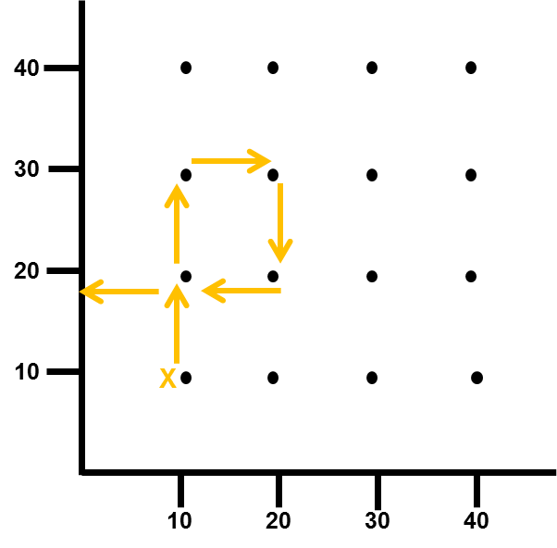
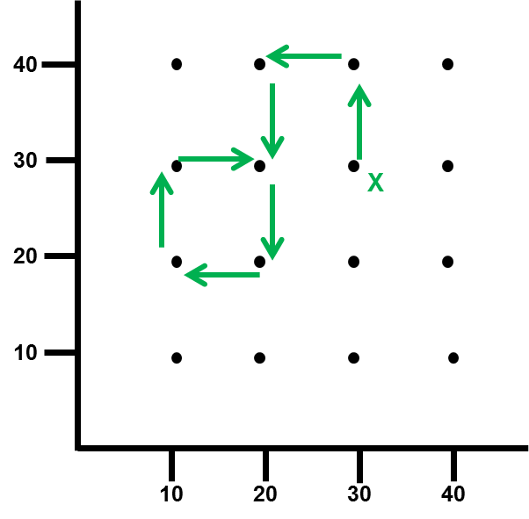
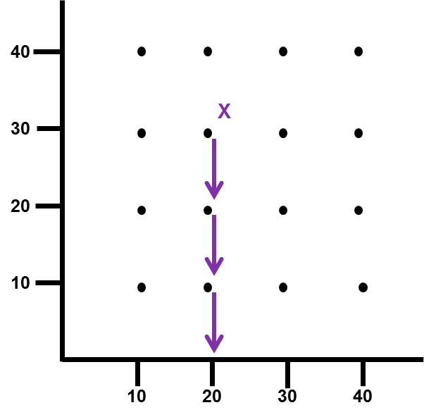
SELECT, IsWithin POINT
SELECT col1, my_point FROM t1
WHERE solr_query=
'{ "q" : "my_point : \"IsWithin(BUFFER(
POINT(30 30), 1))\"" }';
col1 | my_point
------+-------------------
3 | POINT (30.0 30.0)
Notes:
The first query; point within range of point.

Slide 17
SELECT, IsWithin POINT
SELECT col1, my_point FROM t1
WHERE solr_query=
'{ "q" : "my_point : \"IsWithin(BUFFER(
POINT(20 30), 1))\"" }';
col1 | my_point
------+-------------------
4 | POINT (20.0 30.0)
Notes:
The second query; point within range of point.

Slide 18
SELECT, IsWithin POINT
SELECT col1, my_point FROM t1
WHERE solr_query=
'{ "q" : "my_point : \"IsWithin(BUFFER(
POINT(20 30), 10))\"" }';
col1 | my_point
------+-------------------
4 | POINT (20.0 30.0)
3 | POINT (30.0 30.0)
Notes:
The third query; point within range of point.

Slide 19
IsWithin using LINESTRING, Odd results-
SELECT * FROM t1 WHERE
solr_query=
'{ "q" : "my_line : \"IsWithin(BUFFER(
POINT(20 30), 40))\"" }';
Notes:
The IsWithin operator will not error when referencing a LINESTRING (a set of points), but the results are nonsense.
For LINESTRING we should use, Intersects.

Slide 20
LINESTRING, Intersects
SELECT col1, my_line
FROM t1 WHERE
solr_query='my_line:"Intersects(
POINT(20 20))"';
col1 | my_line
------+-----------------------------------------------------------------------------------------------------
4 | LINESTRING (20.0 30.0, 20.0 20.0, 10.0 20.0, 0.0 20.0)
3 | LINESTRING (30.0 30.0, 30.0 40.0, 20.0 40.0, 20.0 30.0, 20.0 20.0, 10.0 20.0, 10.0 30.0, 20.0 30.0)
2 | LINESTRING (10.0 10.0, 10.0 20.0, 10.0 30.0, 20.0 30.0, 20.0 20.0, 20.0 10.0, 20.0 0.0)
1 | LINESTRING (10.0 10.0, 10.0 20.0, 10.0 30.0, 20.0 30.0, 20.0 20.0)
Notes:
The fourth query; linestring intersecting a point.

Slide 21
LINESTRING, Intersects
SELECT col1, my_line FROM t1
WHERE solr_query='my_line:
"Intersects(POINT(30 40))"';
SELECT col1, my_line FROM t1
WHERE solr_query=
'{ "q" : "my_line : \"Intersects(
POINT(30 40))\"" }';
// same for both
col1 | my_line
------+-----------------------------------------------------------------------------------------------------
3 | LINESTRING (30.0 30.0, 30.0 40.0, 20.0 40.0, 20.0 30.0, 20.0 20.0, 10.0 20.0, 10.0 30.0, 20.0 30.0)
Notes:
The fifth query; linestring intersecting a point.

Slide 22
End to End Example:
Working with routes-
IsWithin, Intersects, POINT, LINESTRING
REVIEW
Notes:
This page marks the end of the (end to end) example; how to work with routes

Slide 23
End to End Example:
Working with time series-
Ranges of dates/times.
Notes:
At this point we present an example; complete, and end to end.
This example details how to work with time series.

Slide 24
CREATE TABLE, add data, CREATE SEARCH INDEX
CREATE TABLE t2
(
col1 TEXT,
my_dates 'PointType',
PRIMARY KEY ((col1))
);
INSERT INTO t2 (col1, my_dates)
VALUES ('101', 'POINT(2 5)');
VALUES ('102', 'POINT(2 3)');
VALUES ('103', 'POINT(4 5)');
VALUES ('104', 'POINT(1 2)');
VALUES ('105', 'POINT(1 3)');
VALUES ('106', 'POINT(1 6)');
CREATE SEARCH INDEX ON t2
WITH COLUMNS col1, * {excluded : true } ;
Notes:
CQL CREATE TABLE, add data, CREATE SEARCH INDEX.

Slide 25
ALTER SEARCH INDEX
ALTER SEARCH INDEX SCHEMA ON t2
ADD types.fieldType[@name='ft_rpt',
@class='solr.SpatialRecursivePrefixTreeFieldType',
@geo='false',
@worldBounds='0 0 365 365',
@maxDistErr='1', @distErrPct='0'];
ALTER SEARCH INDEX SCHEMA ON t2
ADD fields.field[@name='my_dates', @type='ft_rpt',
@indexed='true', @multiValued='false', @stored='true',
@docValues='true'];
RELOAD SEARCH INDEX on t2;
REBUILD SEARCH INDEX on t2;
No ENVELOPE, like earlier
Notes:
CQL ALTER SEARCH INDEX. Comments:
geo=‘false’, for spatial data/constructs.
worldBounds equal zero to 365 (or 366), the number of whole days in a year.
maxDistErr and distErrPct configure for exact match on day number.

Slide 26

Same Data, Plotted
106, 1-6
6
101, 2-5
103, 4-5
5
End (Day)
y-axis
4
105, 1-3
102, 2-3
3
2
104, 1-2
1
1
2
3
4
5
6
Start (Day), x-axis
Notes:
The data we are using, plotted. Comments:
The x-axis records start day. The y-axis, end day.
Since an event can not end before it starts, all points are above a 45 degree slope.
6 points display. For example, record 101 began on day 2, and ended on day 5.

Slide 27
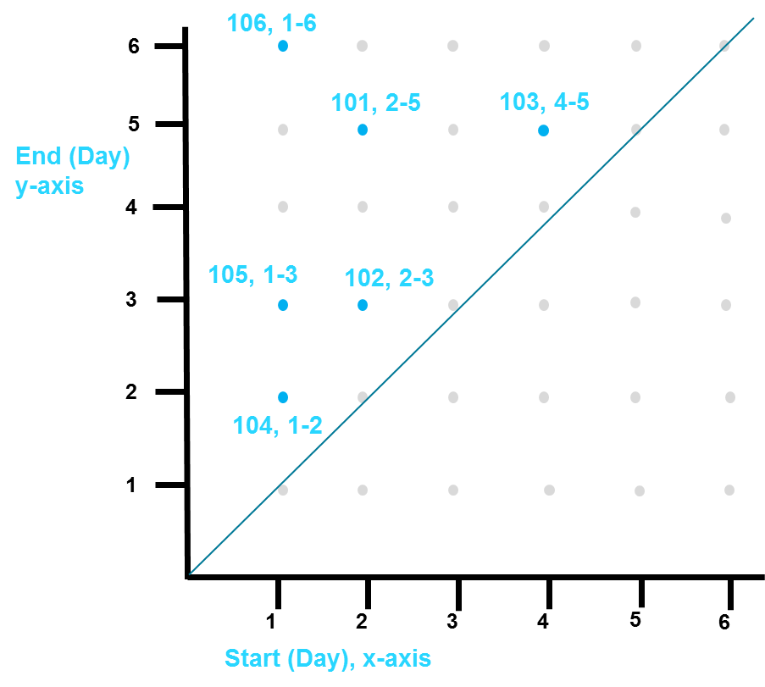
Contains; exclusive to range
SELECT col1, my_dates
FROM t2
WHERE solr_query=
'{ "q" : "*:*", "fq" : "my_dates:
[0,1 TO 3,365]" }';
col1 | my_dates
------+-----------------
104 | POINT (1.0 2.0)
102 | POINT (2.0 3.0)
105 | POINT (1.0 3.0)
x
y
y
x
Notes:
The first query; records contained wholly within a range.

Slide 28
Intersects; not exclusive to range
SELECT col1, my_dates
FROM t2
WHERE solr_query=
'{ "q" : "*:*", "fq" : "my_dates:
[1,0 TO 365,3]" }';
col1 | my_dates
------+-----------------
104 | POINT (1.0 2.0)
106 | POINT (1.0 6.0)
102 | POINT (2.0 3.0)
105 | POINT (1.0 3.0)
101 | POINT (2.0 5.0)
Notes:
The second query; records contained in part or in whole to a range, an intersection.

Slide 29
On a given date/time
SELECT col1, my_dates
FROM t2
WHERE solr_query=
'{ "q" : "*:*",
"fq" : "my_dates:
[4,0 TO 10,4]" }';
col1 | my_dates
------+-----------------
103 | POINT (4.0 5.0)
106 | POINT (1.0 6.0)
101 | POINT (2.0 5.0)
Notes:
The third query; records on a given date.

Slide 30
Not on a given date/time
SELECT col1, my_dates
FROM t2
WHERE solr_query=
'{ "q" : "*:*",
"fq" : "NOT
my_dates:[4,0 TO 10,4]" }';
col1 | my_dates
------+-----------------
104 | POINT (1.0 2.0)
102 | POINT (2.0 3.0)
105 | POINT (1.0 3.0)
Notes:
The fourth query; records not on a given date.

Slide 31
End to End Example:
Working with time series-
Ranges of dates/times.
REVIEW
Notes:
This page marks the end of the (end to end) example; how to work with time series.

Slide 32
End of Module:
Notes:
This page marks the end of this module.

